Slide 1
VQManager e-Portfolio
New Apprenticeship Standards

Slide 2
The UK is currently seeing the roll-out of the New Apprenticeship Standards, incorporating a Standard and an Assessment Plan. Delivering them successfully will require a new approach.
Already it is clear that the primary challenge for providers is knowing with certainty when their Apprentices are ready for End Point Assessment.
VQManager is designed to simplify the delivery and tracking of all aspects of these New Apprenticeship Standards, so that providers can be confident that their Apprentices will be successful at End Point Assessment.
VQManager

Slide 3
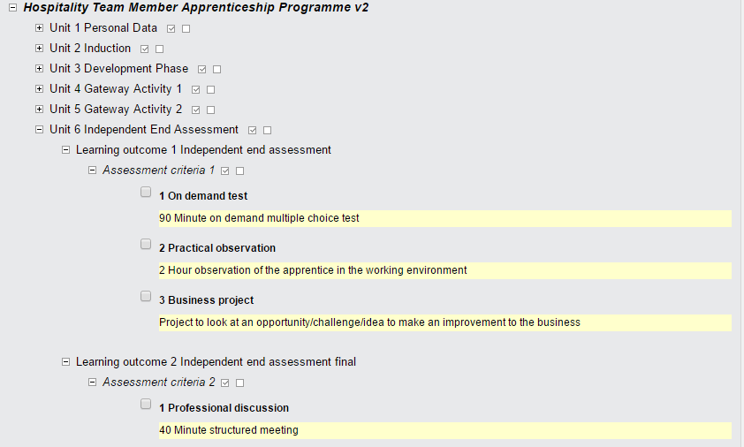
Apprentices are ready for End Point Assessment.
>>> www.skillwise.net

Slide 4
How will VQManager help with the delivery of the New Apprenticeship Standards?
Through working with a number of organisations delivering the New Apprenticeship Standards, we have developed a very robust, dependable and trackable approach – all governed and managed through the VQManager e-portfolio.
Our off-line app, VQMobile, allows assessment to occur even when an internet connection is unavailable – allowing assessment to continue whatever the environment.
>>> www.skillwise.net

Slide 5
How are the Standards presented?
In their original form, most Standards provide written descriptions of competencies. In this format, it is difficult for providers to be certain that all of the Standards’ requirements have been satisfied.
To make them easier to work with we translate the Standards into a matrix of identifiable, standalone competencies (or behaviours or knowledge items). This provides a far more easily manageable structure as it allows individual competencies to be isolated and ticked off, and it allows tracking reports to show the precise progress of each Apprentice.
QManager

Slide 6
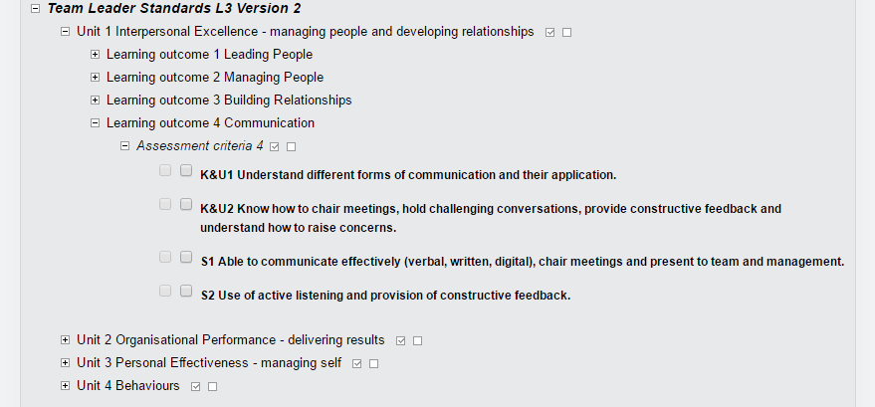
We translate the Standards into a matrix of identifiable, standalone competencies (or behaviours or knowledge items).
>>> www.skillwise.net

Slide 7
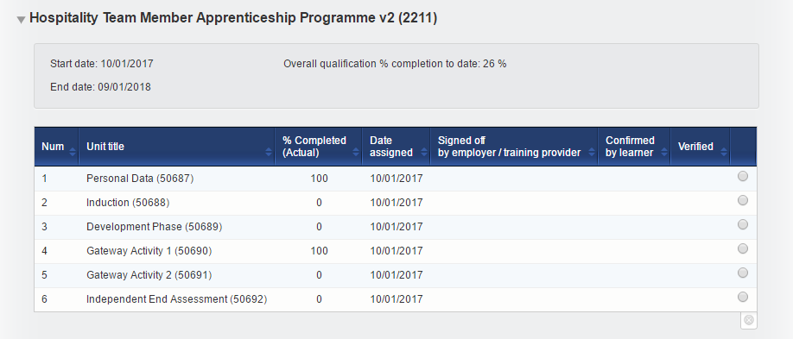
Tracking reports show the precise progress of each Apprentice.
>>> www.skillwise.net

Slide 8
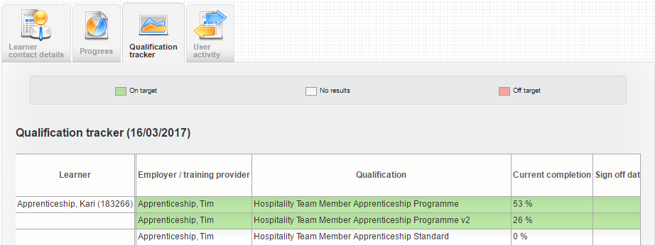
Tracking reports show the precise progress of each Apprentice.
>>> www.skillwise.net

Slide 9
How are the Assessment Plans presented?
Then, we take the contents of the Assessment Plan, we incorporate any other milestone events or documentation you may use, and translate these into a timeline of activities. Again, this becomes trackable and reportable so you are able to accurately track Apprentices’ real-time progress against their Assessment Plan.
QManager

Slide 10
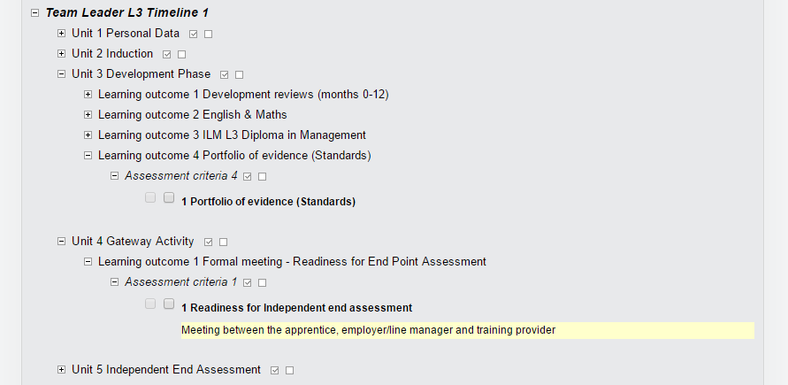
We take the contents of the Assessment Plan, we incorporate any other milestone events or documentation you may use, and translate these into a timeline of activities.
>>> www.skillwise.net

Slide 11
Three-party assessment.
Most NAS qualifications will be delivered using a three-party approach, whereby each Apprentice is supported by a Training Provider (TP) and a manager at their place of work (Workplace Manager, WM).
The Training Provider and the Workplace manager share the responsibility for ensuring that the Apprentice gains all of the knowledge and experience required by the Standard and the Assessment Plan.
>>> www.skillwise.net

Slide 12
What does the Employer/Workplace Manager see?
To enable the TP and the WM to collaborate, VQManager provides both roles with the ability to view their Apprentices’ progress, to add evidence to their portfolios, to carry out or view progress reviews and to communicate with them.
A unique function within VQManager allows pre-defined activities (such as some of those within the Assessment Plan) to be pre-mapped against their intended outcomes. This means that as Apprentices gain experience, both their activities and their achievements can be rapidly and automatically mapped against the Assessment Plan and the Standards.
QManager

Slide 13
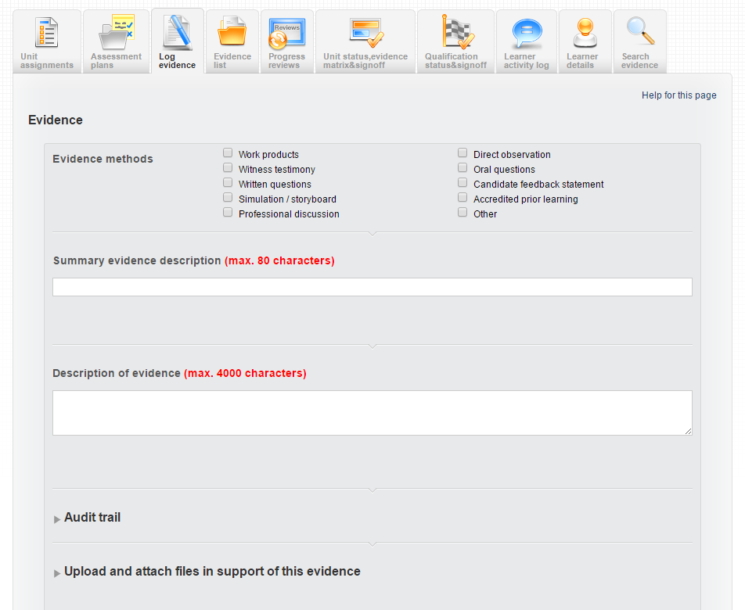
Employer/Workplace Manager can add evidence to their Apprentice’s portfolio.
>>> www.skillwise.net

Slide 14
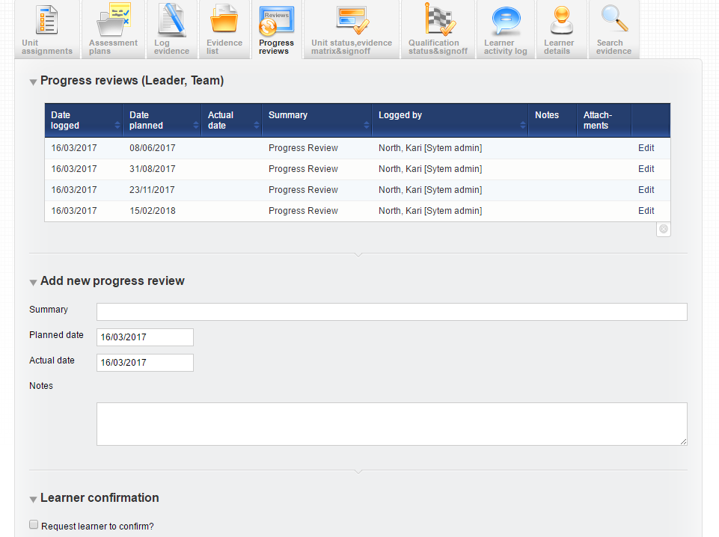
Employer/Workplace Manager can carry out or view
progress reviews.
>>> www.skillwise.net

Slide 15
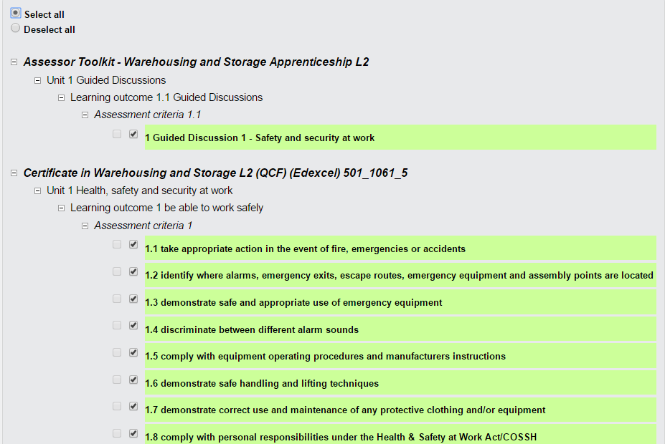
Using SmartWorx, activities and achievements can be rapidly and automatically mapped against the Assessment Plan and the Standards.
>>> www.skillwise.net

Slide 16
What does the Apprentice see?
The Apprentice’s view provides them with the ability to view their progress, to see their Assessment Plan(s) and to log evidence. Now, through a new Diary area, they can also record diary entries and reflections.
Diary entries establish a lasting record of the Apprentice’s perspective, thus creating a true 360º record.
>>> www.skillwise.net

Slide 17
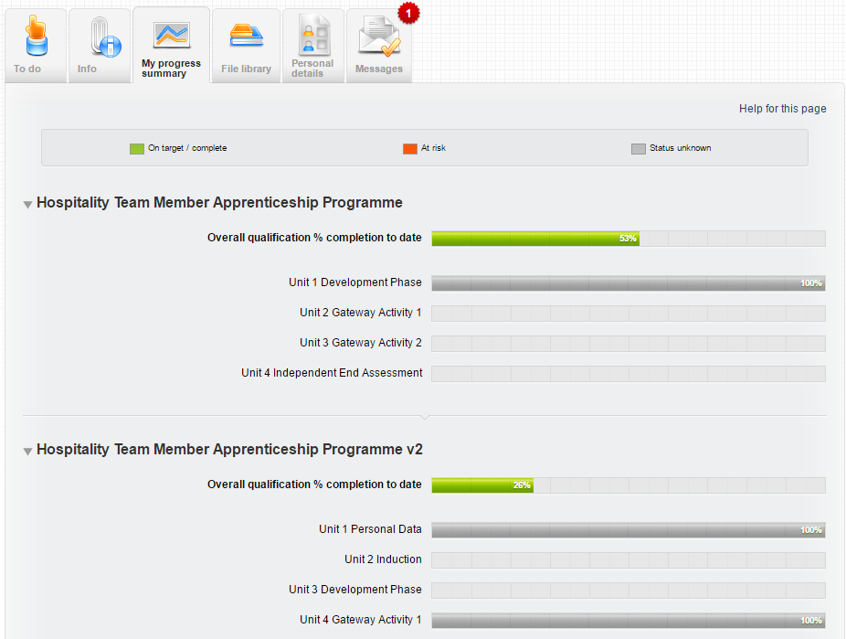
Apprentices can view their progress.
>>> www.skillwise.net

Slide 18
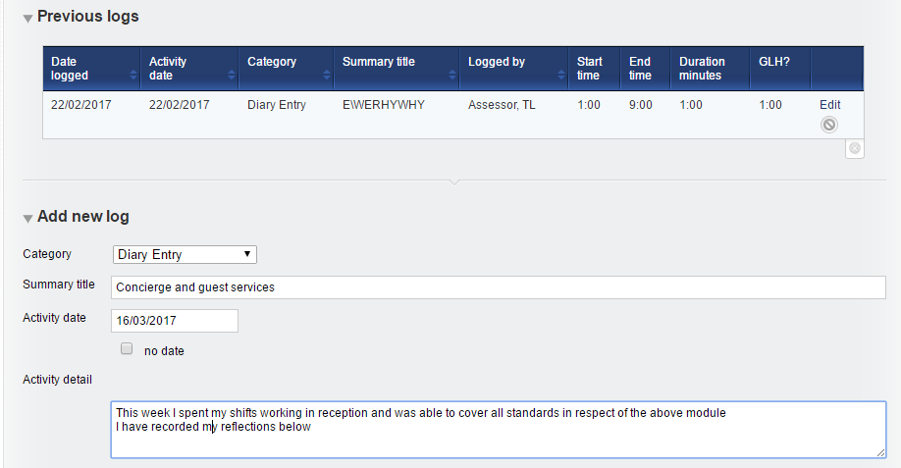
Apprentices can log reflections in their diary.
>>> www.skillwise.net

Slide 19
We want to proceed with VQManager – what happens next?
SkillWise will contact you and:
Gain a full understanding of your own unique process of delivery.
Discuss how your Standards can be presented to make them more manageable.
Construct a ‘timeline’ for each, containing all aspects of the Assessment Plan combined with your own unique milestones.
Map any pre-defined assessment activities against their intended outcomes.
Demonstrate the reports to show how these will help you track all of your Apprentices.
Speak to one of the VQManager team today and we will help you to deploy an e-portfolio that will simplify all of your assessment and tracking processes.
e: uksales@skillwise.net w: skillwise.net t: 0845 519 4634
SkillWise UK Ltd. Venture House, Arlington Square, Downshire Way, Bracknell, Berkshire RG12 1WA United Kingdom

