Slide 1
User Group Meeting
November 29th 2018

Slide 2
Welcome
Today’s agenda:
Welcome - today’s aim and housekeeping | Paul
Review of developed functions | Kari
Development in progress | Kari
Security – Passwords / GDPR / Human Firewall | Paul and Jo
Suggestions for future development | Jo
Lunch | All
Continuation of development suggestions | Jo
Voting | All
Close | Paul

Slide 3
VQManager
VQManager
Enhancements

Slide 4
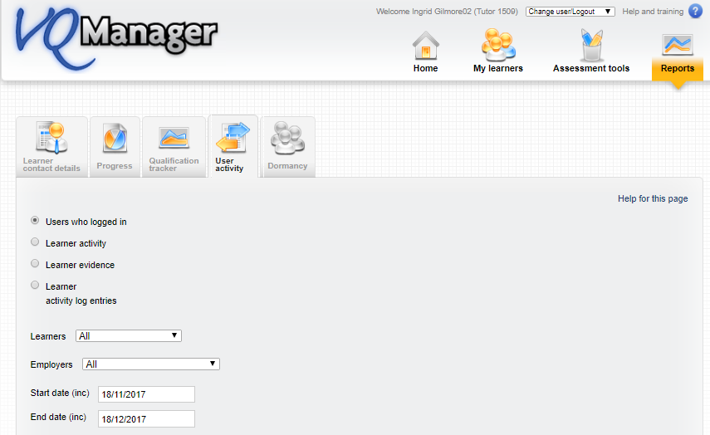
VQManager
Reports
User who logged in report – add employer field
We have added an employer field to this report to enable filtering by this category.

Slide 5
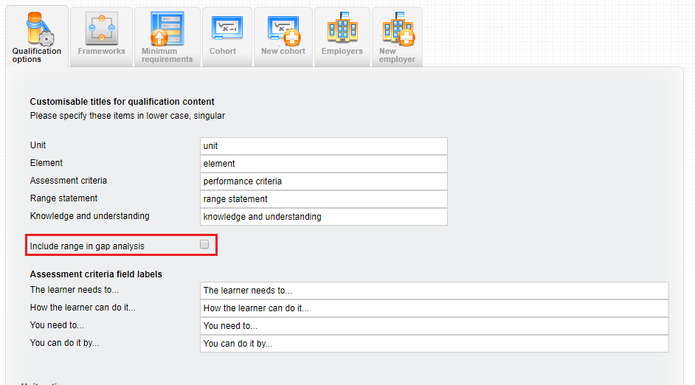
VQManager
1
Adding Range to Gap Analysis report
We have now added an option for clients who use range statements, to see the range in the GAP analysis report. This is visible for both the learner and the assessor.
Org Admins can switch this on for the relevant qualifications in the ‘My Organisation’ tab. It is switched off for all qualifications by default.

Slide 6
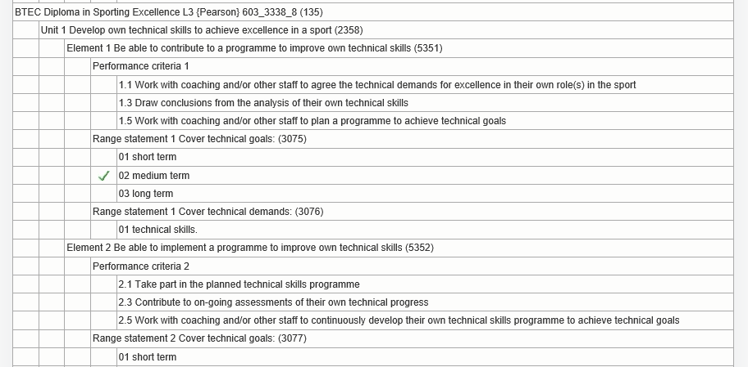
VQManager
2
All range is listed, and range that has been covered shows with a green tick next to it. This is so that users can easily check if they have covered enough range, for example, where the standards call for the learner to cover four of a possible six range statements.

Slide 7
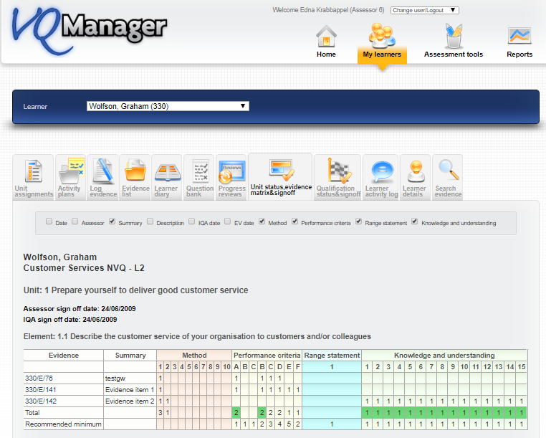
VQManager
Adding unit sign off date to Evidence Matrix report
We have added a new area to the Evidence Matrix report, showing whether the unit has been signed off by the assessor and IV/IQA and the date this was completed.

Slide 8
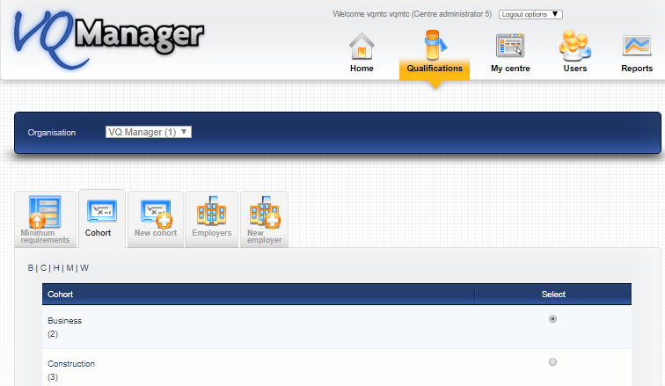
VQManager
Allow customisation of 'Curriculum Area' name
We have added an option for the “Curriculum area” field to be re-named for your organisation. If you would like this field to be called anything other than Curriculum area, please contact SkillWise to make the change for you. The example below shows where the field is now called “Cohort”
This improves clarity and flexibility of the system in respect to filtering data, especially in reports.

Slide 9
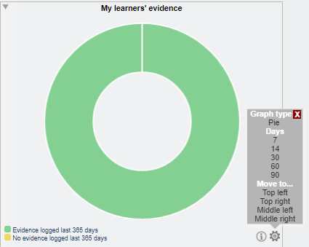
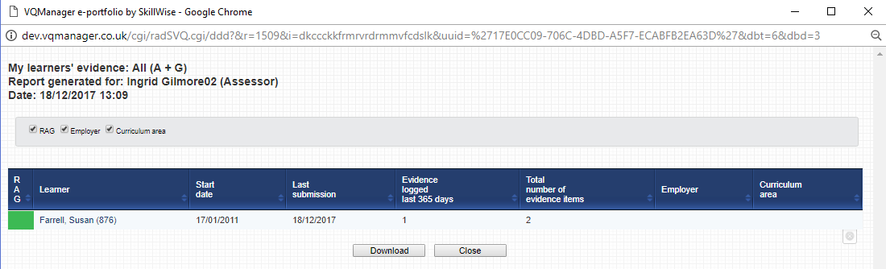
VQManager
New Dashboard report - Evidence logged in last x days
For the Assessor, we have added a new Dashboard graph showing when evidence was last logged for a learner. Some learners don't log their own evidence, so this data includes all evidence logged whether it is by the Learner, Trainee Assessor or Qualified Assessor. Normal settings are available using the cog icon to set the date range.

Slide 10
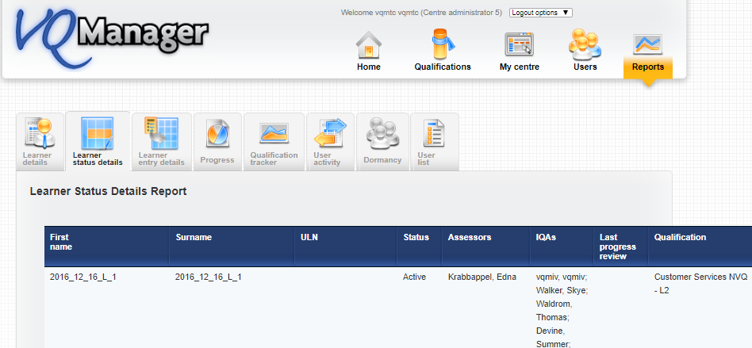
VQManager
Learner Status Details - add ULN column
To improve usability, we have added a new column to this report for ULN

Slide 11
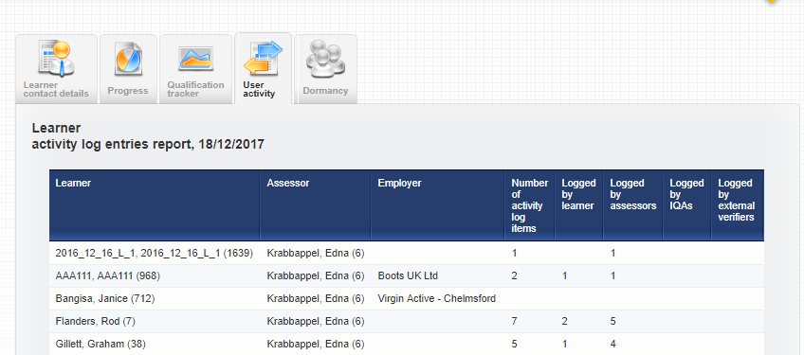
VQManager
New Report - Learner activity log entries
We have created a new report called Learner activity log entries to show additional information, namely:
Number of logs in the Learner Activity Log (regardless of who logged them)
Number of logs added by learner
Number of logs added by assessor
Number of logs added by IQA
Number of logs added by EQA
This report is available in “view” and also “download” form and is available to Centre Admin, Assessor, IQA, Line Manager and OSU.

Slide 12
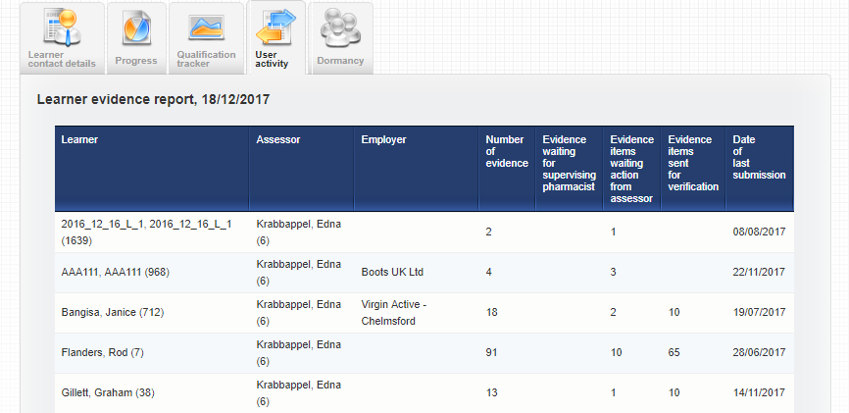
VQManager
New Report - Learner evidence
We have created a new report called Learner Evidence to show additional information, namely:
Number of evidence items waiting to be actioned by Expert Witness
Number of evidence items waiting to be actioned by Assessor
Number of evidence items sent to IQA
Date of last submission
This report is available in “view” and also “download” form and is available to Centre Admin, Assessor, IQA, Line Manager and OSU.

Slide 13
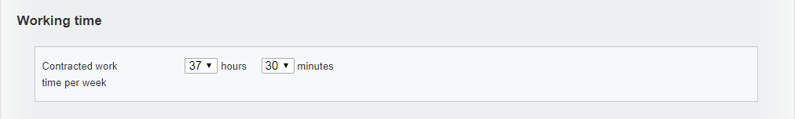
VQManager
1
Off the job training
The new Apprenticeship Standard learners are required to show they have spent 20% of their paid working time on off-the-job training.
The system will use this, and the start and end dates for the learner, to work out total off-the-job hours required for the learner over the course of their study. (hours per week x 0.2) x no. of weeks between start and end date. The field will allow for fractions of hours, for example 37.5 hours worked per week.
Target start date for OTJT is the earliest of the start dates for the qualifications assigned, and target end date is the last of the end dates for the qualifications assigned.
Annual leave is not subtracted from this calculation. This provides a ‘buffer’ to make sure learners are fulfilling the 20% with time to spare.
Where a learner has both GLH and OTJT set up against their account, users can log GLH and OTJT with different start and end times in the same log, (Activity or Diary), because these functions are completely separate.

Slide 14
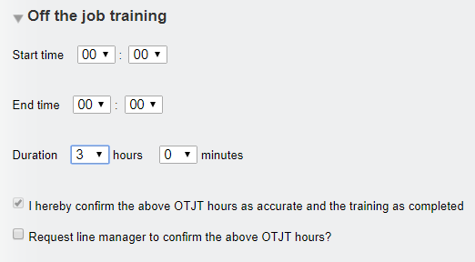
VQManager
2
Function allows for recording off the job training in both the Diary and Learner Activity Log
The off the job training fields will only appear where the “Working time” field in the User profile has been completed, i.e. the function above is hidden for all users it is not relevant to.
Additional areas:
New Dashboard graph showing progress
New reports showing progress
Progress Reviews showing OTJT progress

Slide 15
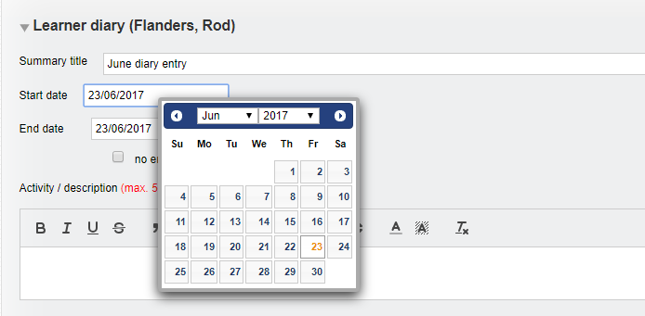
VQManager
Diary
Allow editing of start date in Diary
When a Diary entry was saved and then the learner or assessor returned to it for editing, the start date was not a field which could be edited. This has now been changed so that users can edit this date.

Slide 16
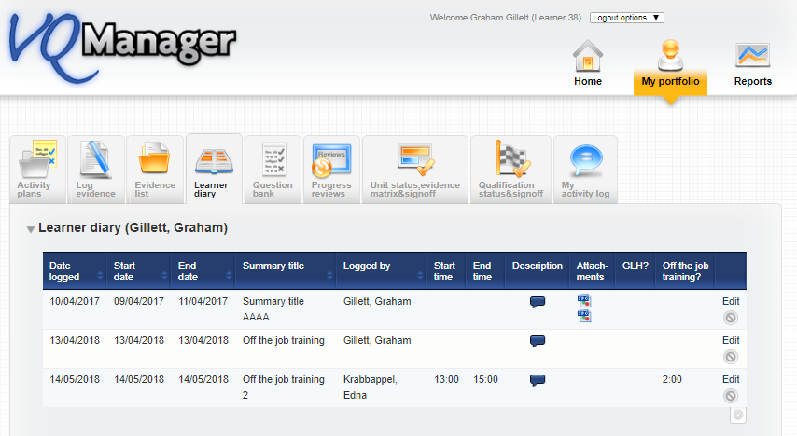
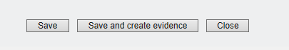
VQManager
Retrospectively convert Diary entries to evidence
VQManager now allows for diary entries to be converted into evidence after they have been saved, rather than just at the point of first saving.
The user (learner or assessor) selects “Edit” and the entry will open.
The user can make any edits they wish, and is presented with the options to “save” or “save and create evidence”, allowing the entry to be converted into evidence.

Slide 17
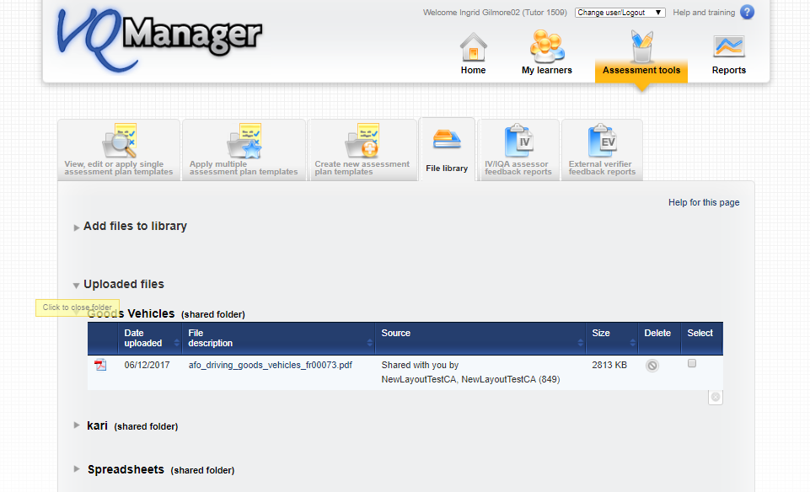
VQManager
File Library
Twisties added to folders in File Library
We have added twisties to the folders within the File Library. Select the triangle to close or open the folder.
This is applicable for anyone with a file library

Slide 18
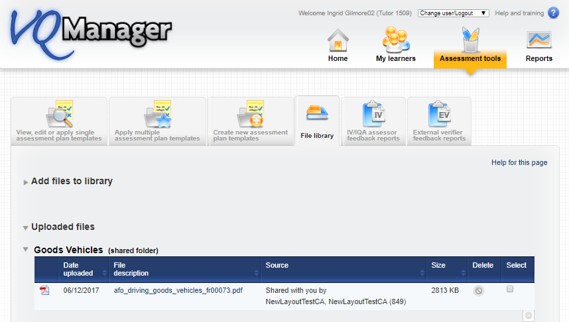
VQManager
Sharing folders in file library as well as files
Centre Admins / File Librarians are now able to share the folder a file in is, as well as the file itself.
When they select a file to share, users can tick a box ‘share in folder’. This will copy the file to the target users, and place it in a folder with the same name.
If subsequent files are shared from the same folder, they will appear together in the one folder for the target users.
The names of shared folders cannot be edited by target users. However, they can move copied files out of the shared folder into folders of their own creation if they prefer

Slide 19

VQManager
Assessment plans
Learner confirmation not required in Assessment Plan
Where learner confirmation isn't requested/required for an assessment plan a new message has been added saying just that.

Slide 20
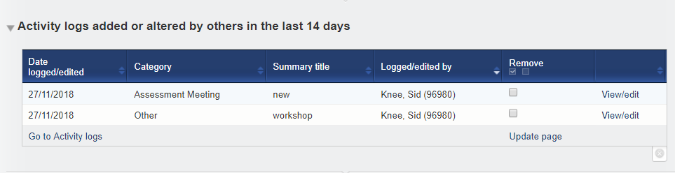
VQManager
To Do
Learner Activity Log changes added to learner and assessor To Do list
We have added a notification for learners and assessors where another user has added or altered an item in the Learner Activity Log.

Slide 21
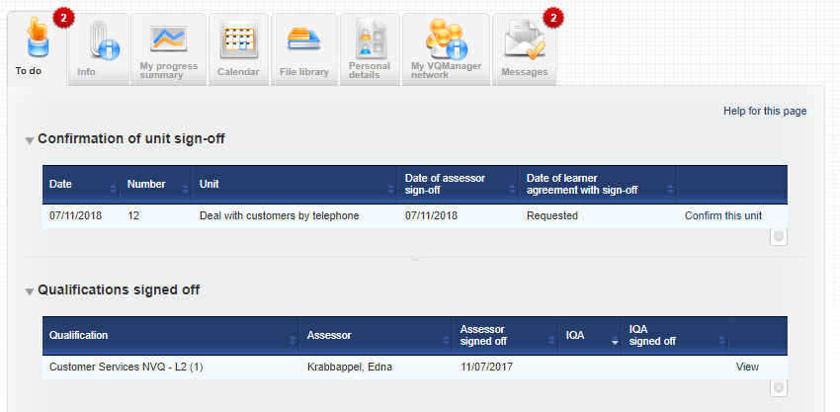
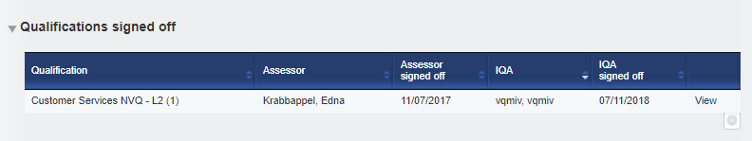
VQManager
To Do list entry for learner when qualification is signed off
In addition to unit sign off notification, learners will now be notified on their To Do list when the assessor signs off a qualification.
The system also updates the learner if and when the IQA/IV subsequently signs off the qualification.

Slide 22
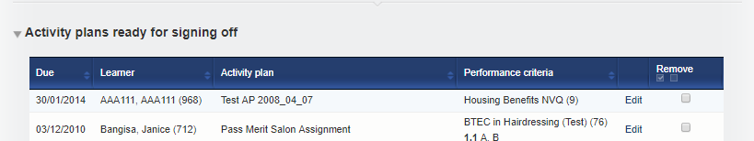
VQManager
Reminder to sign off assessment/activity/assignment plans
The system will now show assessors if all the criteria within an assessment plan has been covered.
At the point where all criteria in the plan are ticked off in evidence which has then been sent for verification, the assessor will receive a To Do tab message:
Clicking on 'edit' takes the assessor to the named assessment plan, so they can review it and sign it off if they wish. If the assessor does not wish to sign the plan off, they can select the plan by ticking the box and “update page” to remove it from the list.
This is a centre switch, do please let us know if you do not want this switched on.

Slide 23
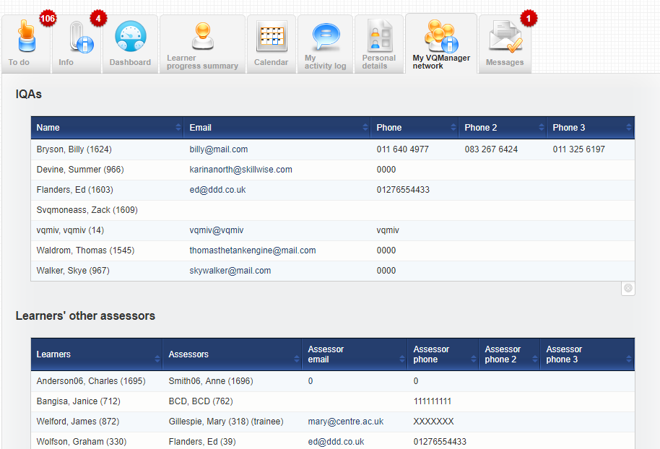
VQManager
Add new tab so users can see who they are linked to
Users are now able to see who they are linked to in a new tab called My VQManager network located on their Home tab
Assessors can see
  IQAs they are linked to
  which other assessors are linked to their learner, with trainee assessors differentiated too
Learners can see:
  Assessors they are linked to
  IQAs they are linked to

Slide 24
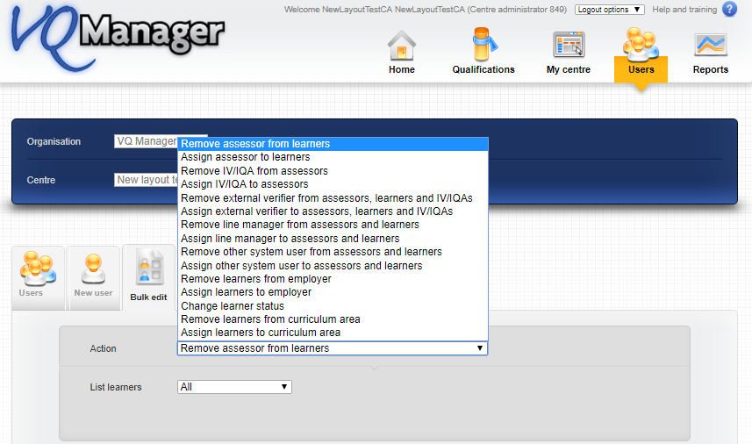
VQManager
Centre Admin
Add Curriculum Area to bulk edit function
We have added the ability to assign and remove learners from a curriculum area in bulk.

Slide 25
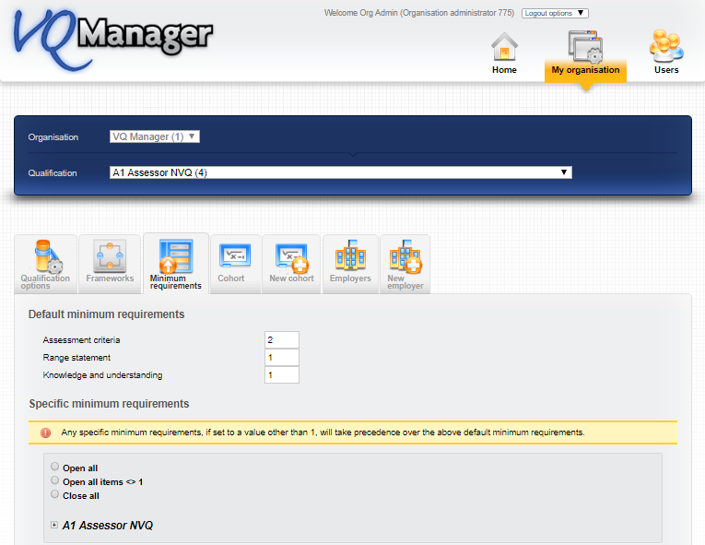
VQManager
Add 'open all' to minimum requirements page
There is a new 'open all' option on the minimum requirements page for both Org Admin and Centre Admin. This should speed up the process when setting minimum requirements as Org Admin and also when viewing them as Centre Admin.

Slide 26
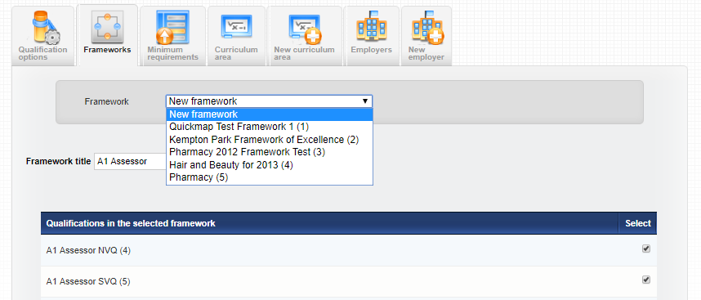
VQManager
Work has been completed to improve the creation and assigning of frameworks
Frameworks can be created by the Org Admin to include a bundle of qualifications for an Apprenticeship, for example a main aim, Functional Skills and ERR, or Standards and a Programme of Delivery.
The Org Admin links the qualifications into Framework. This function will appear in the My Organisation tab.
The Framework will need a title but the start and end dates are set later. The framework can be edited if the constituent qualifications change. This will not affect learners already assigned the previous set of qualifications.

Slide 27
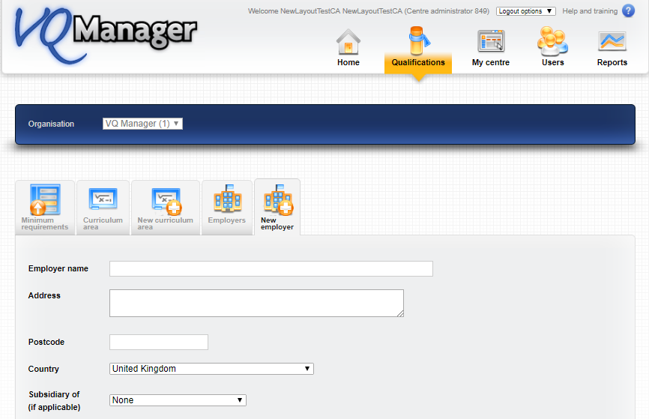
VQManager
Allow Centre Admin to see Employer list and add new Employers
We have added the ability for the Centre Admin rather than just the Org Admin to see and add to the Employer list.
Note: this list still pertains to all centres in your Org, so if you have more than one centre for live users, you will need to include relevant employers for all centres in a single list on VQManager.

Slide 28
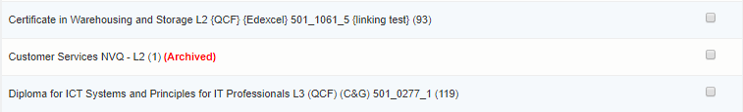
VQManager
Archiving of quals that have expired
Previously, when a qualification expired, and all learners have finished working on it, we have needed to remove it altogether from your centre if you wanted to clean up user views.
It is now possible to mark a qualification as archived. This means it is hidden in page views and drop-downs for assessors, and some screens for the Centre Admin. This action is completed by someone from SkillWise upon request.
The Centre Admin can see an archived qualification in a learner’s profile where it was assigned to that learner before it was archived. The archived qualification will not appear in the list to be assigned to new learners.
IQAs and EQAs can still view evidence associated with archived qualifications, as can Learners. Learners can still log in and view their work after they have completed the qualification.

Slide 29
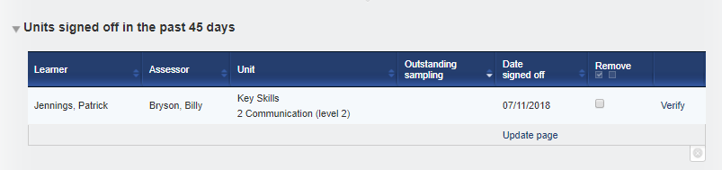
VQManager
Allow centres to change no. of days IQA/IV sign off notification
Clients can now change the IQA/IV notifications in respect of the number of days’ notice. The default is set at 30 days but can be altered if required.
If you should like a setting different to 30 days, please contact SkillWise to make the changes for you.

Slide 30
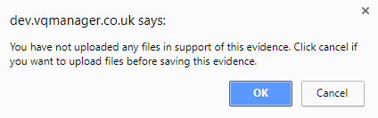
VQManager
Evidence
Add pop-up warning if user is saving evidence with no attachment
We have added a pop up reminder for both Learners and Assessors where evidence is created with no attachment. This is simply to remind them that no attachment has been added in case they have forgotten. If no attachment was intended “Ok” closes the popup, and saves the evidence.

Slide 31
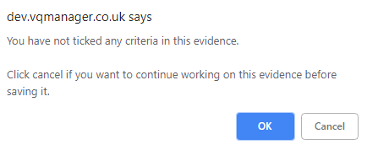
VQManager
Create pop up where user saves evidence with no criteria ticked
We have added a pop up reminder when saving evidence, which will appear if the user (learner or assessor) hasn't ticked any criteria. The message for no criteria is shown when there are criteria check boxes available for checking but none are checked.

Slide 32
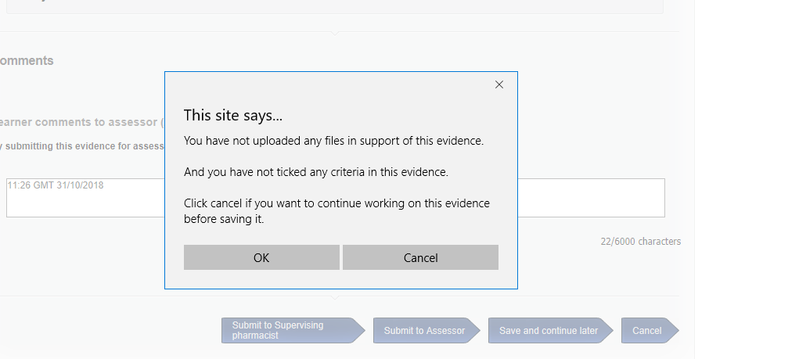
VQManager
Where both no file and no criteria are selected
When both these messages need to be shown they are combined into one prompt:

Slide 33
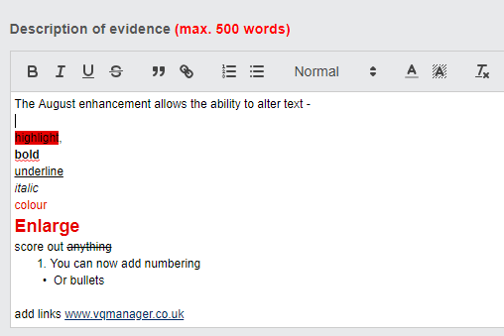

VQManager
Allow hyperlinks and formatted text in evidence
VQManager now allows rich text and hyperlinks in the following fields:
Evidence description
Diary description
Progress review notes
Activity log details (all users)
Assessment plan notes
Hyperlinks inserted here will open in a new browser tab. This will enable learners and assessors to link to work stored on other websites.

Slide 34
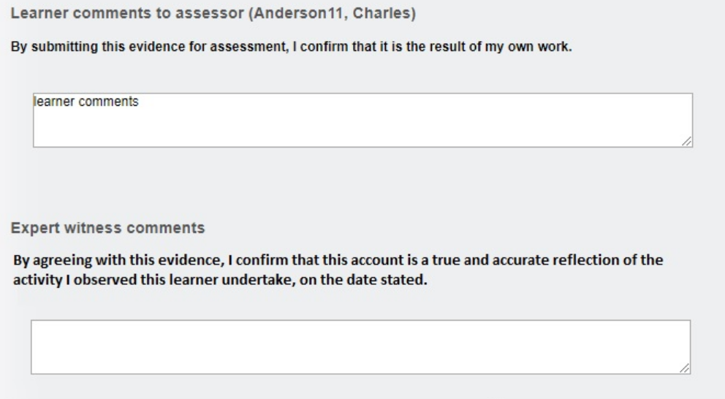
VQManager
Add declaration to Expert Witness comments
To mirror the declaration we already have above the Learner comments box, we have now added one for the Expert Witness.

Slide 35
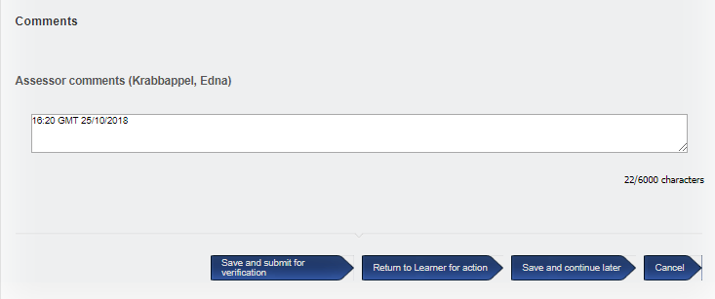
VQManager
Add date stamp in comments box
We have added an automatic date/time stamp to the comments boxes throughout VQManager to indicate whenever a new comment is added.
The date stamps forms part of the text in that box and as such can be edited by the users. The audit trail will still indicate the time and date of the entry if this is altered. If no comment is saved, the date stamp also isn’t saved.
Where VQM is being used in different time zones, the time stamps are all “server time” which is GMT.

Slide 36
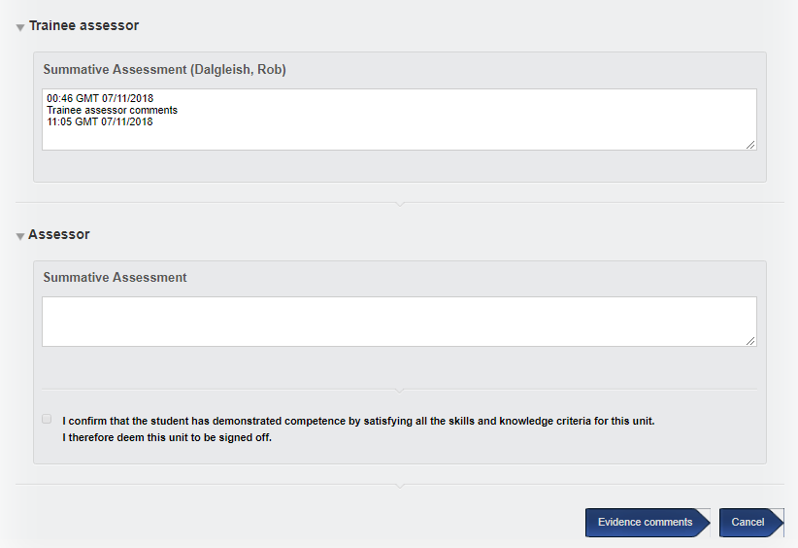
VQManager
New trainee assessor comments box to unit and qual sign off
We have added a comments box at unit and qualification sign off for a trainee assessor. This change means that trainee assessors will now lose access to signing off units and qualifications.
Unlike the qualified assessor area, there is no tick box associated with this new comments box. The tick box remains with the qualified assessor along with their own comments box. The unit and qualification sign off date in all the tabs and reports etc. is associated with qualified assessor sign off.

Slide 37
VQManager
Add character limit information to all comments boxes
In the same way we have previously had character counts to some fields in the Log Evidence tab, we have now implemented similar character limits throughout VQManager. We have previously had a couple of instances where users have tried to save very large amounts of data in comments boxes, and data has been lost in transfer. This development is to reduce that risk to a minimum.

Slide 38
VQManager
IQA/IV’s
Link IQAs to specific learners and/or quals
The new centre switch allows the CA to link the IQA to specific learners and/or specific qualifications, as well as specific assessors. This is especially useful in the case where the IQA is working with only some of an assessor’s learners; or for example only deals with Functional Skills and no other qualifications.
When this centre switch is activated, IQA user profiles get the same "associate with users" and "qualification assignments" tables as EQAs. The linking is therefore the same as EQA and Learners and Assessors are chosen individually.
This is a centre switch. You do not have to have this added to your centre if you are happy for IQAs to be assigned to the Assessors in the way they always have been , so that they automatically view all Learners under those Assessors.

Slide 39
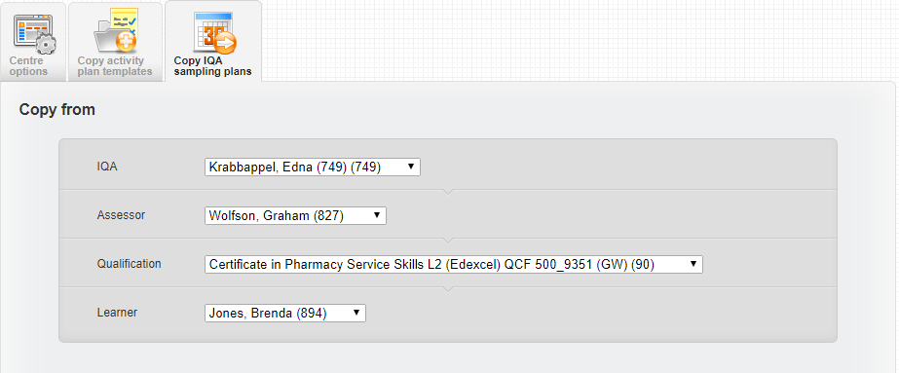
VQManager
Enable copying of sampling plan from one IQA to another
This development allows for the copying of sampling plans from one IQA to another, for example in the situation where an IQA leaves and their work needs to go to someone else. It is important to note that the original plan remains in place with the previous owner, and is a new copy is made for the target user. If the IQA whose plan has been copied stays in the organisation, they can still edit and work with the plan after the copying.
The Centre Admin has a new tab for copying sampling plans.
The system will only allow copying where the ‘target’ IQA is assigned the relevant assessor, qualification and learner. Both planned and completed sampling is copied. The exception is where the ‘target’ assessor already has planned sampling for a given learner and unit. In that case, the planning will not be overwritten. In the notes section, the system will show which sampling was done by whom.

Slide 40
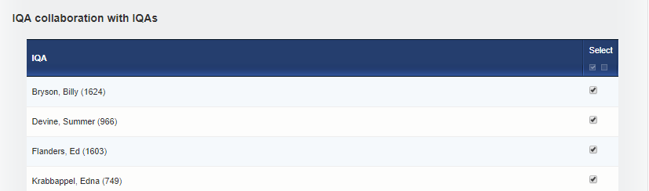
VQManager
1
Allowing IQAs to collaborate and work together
This enhancement is designed to cover functionality required where there is a Trainee IQA who needs supervision, or where there is a Lead IQA who oversees the work of other IQAs in the centre.
In the IQA User Profile, there is a new section to link IQAs together for this purpose.
When the supervising or lead IQA is logged in, we have added an 'IQA collaboration' tab, and included under that a Sampling Plan and Activity Log tab, with 'view only' content so the IQA can see what their linked IQAs are doing.

Slide 41
VQManager
2
In other areas of the IQA view, there is a new comments box in the evidence for the IQAs to comment to each other.
IQA Feedback Reports - there are no functional changes here, just different advice to users on how to use the system.
In the case of a trainee IQA, the trainee can write a report and click ‘save’ (rather than ‘save and submit to assessor’). The qualified IQA is then able to click on ‘view all reports for this assessor’ to view it. Only the person who created the report can edit it.
The Rationale tab is already a shared resource for IQAs who have mutual assessors so that can be located as normal in the IQA Tools tab.

Slide 42
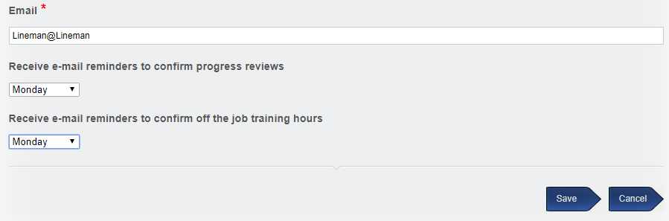
VQManager
Email notifications
E-mail notifications for Line Managers
As the Line Manager role becomes more important, we have added a weekly e-mail notification to remind them to log in and deal with any items on their To Do list. The fields are located in ‘Home’ at the bottom of the ‘Personal details’ tab.
Like the learners, this defaults to Monday when the user is set up, but allows the option for the user to change this when they log in.
The notification emails will include these two to-do items:
Confirmation of progress reviews
Confirmation of OTJT hours

Slide 43
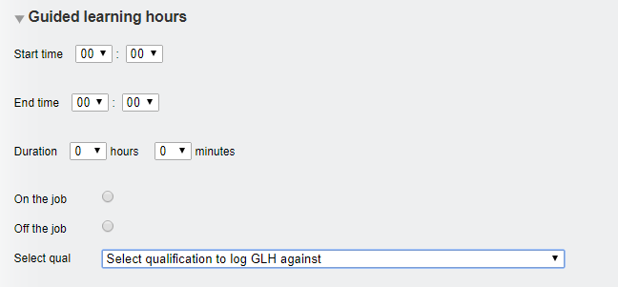
VQManager
Guided Learning Hours - or Total Qualification Time (TQT)
Change to wording in GLH drop-down
We have altered the wording in the GLH function when recording GLH against for clarity.
In the GLH area, it previously said 'select qualification.... if applicable'.
Because is it necessary to select a qualification for the reporting to work, we have changed this to:
‘Select a qualification to log GLH against’
You may have also noticed:
the slider bars have been replaced by drop down boxes for ease of use
Where on/off the job is no required, this is no longer visible

Slide 44
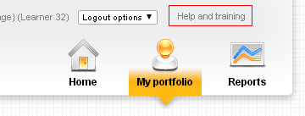
VQManager
Help and Training link – single sign on
We have added a link in VQManager in the Help and Training area so that users can access the www.skillwise.net support page directly from there without having to log in again.
The link for all roles go to the ‘Resources by user’ page. From there the user can also select the videos or troubleshooting as required.

Slide 45
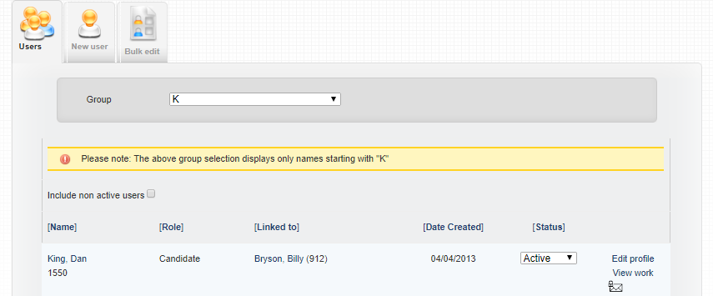

VQManager
Centre Administrator enhanced viewing
VQManager now provides for the Centre Administrator to view the work the learner/assessor/IQA is doing. They now have direct access to these user’s content. Centre Admin can choose the user that they wish to view from their Users >> Users tab.
Select the “View work” link and a new tab will open and you are now logged into the relevant users’ homepage. You can navigate around and view the evidence, progress, assessments and verification that the learner, assessor or IQA has completed or has planned. This works on the same principal as the Other System User / Line Manager view only function.

Slide 46
VQManager
In development
Sharing files along with assessment plans
Bulk edit function - add filters for qualification, curriculum area
In file sharing, add an option to filter users by qualification
Additional emailing in options for Diary and Assessor activity log
Set e-mail destination preference by user

Slide 47
VQManager
Security
Passwords
GDPR
Human Firewall

Slide 48
VQManager
Passwords

Slide 49
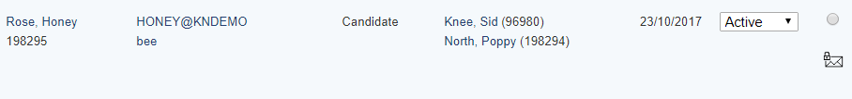
VQManager
Org Admin and Centre Admin removal of view of passwords
Previously the full username and password was visible to both the Org Admin and also the Centre Admin. This was to help facilitate supporting any user forgetting their password. Since then, three new functions have been added and so to improve security and comply with GDPR we have removed this information from view.

Slide 50
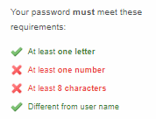
VQManager
Enforcement of strong passwords for all Centre Admins and Org Admins
We are starting to implement the forcing of strong passwords within VQManager.
If you are a Centre Admin or Org admin, you will already have been asked to strengthen your password if your password for either of these roles was not of sufficient strength. New passwords must meet the enforcement parameters. The strength gauge which has been in place for some time but will now insist that the new password is strong.

Slide 51
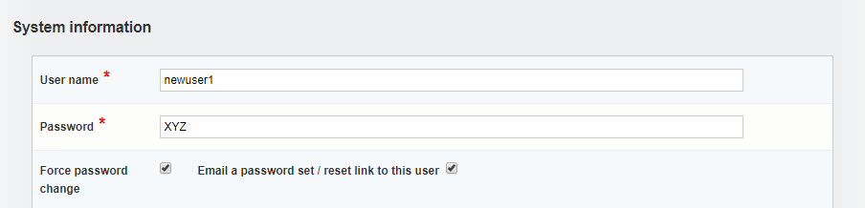
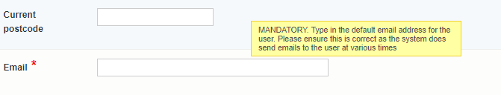
VQManager
When a new user is added to the system by the CA, a password is manually created.
At that time both "Force password change" and "Email a password set / reset link to this user" are available to further secure and support the process.
To ensure the new user knows their username and password the CA ticks to trigger an email to be sent to the user via the email address recorded lower down that page. The link is valid for 7 days.
Once the user creation is saved, the password is no longer visible when the CA reopens the profile.

Slide 52
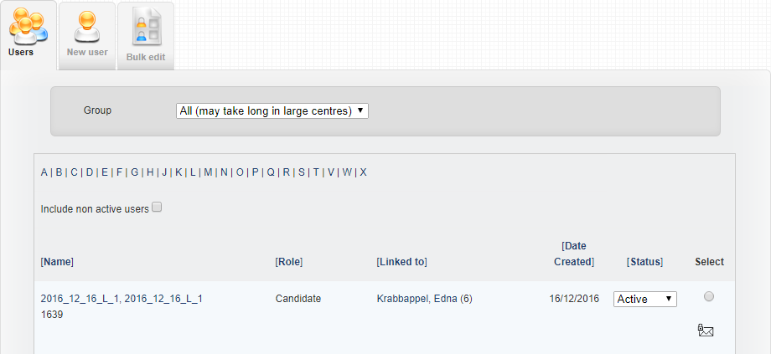
VQManager
At any time later the CA can trigger a password re-set message by selecting the envelope icon on the User tab. The user has 24 hours to follow the link in the message before it expires.

Slide 53

VQManager
At any time later the user can trigger a password re-set message by selecting the “forgotten your password” link on the VQManager login screen. This triggers an email to the user. The user has 24 hours to follow the link in the email before it expires.

Slide 54


VQManager
Time allowances in respect of setting/resetting password messages
Creation of user in VQM - 7 days, user name included and wording is “set”.
Centre Admin requested – 24hrs, user name included and wording is “set”.
Self-requested reset – 24hrs, user name not included and wording is “reset”.

Slide 55
A password re-set message looks like this:
Hi Tracey Udall
Welcome to VQManager!
Your VQManager user name is TRACEY@VQMTEST
You may set your VQManager password by clicking this link:
http://www.vqmanager.co.uk/cgi/radSVQ.cgi/p?rf=9B950701-A3CA-419D-B544-1E2F0BC5393E
This link can be used only once and will expire on 02/03/2018 10:46
Please note that this is a notification email only and any replies to this email address will not be answered. If you have a query regarding this email or any aspect of VQManager, please contact your Assessor or Centre Administrator directly.
You can change your email address recorded in VQManager and unsubscribe from, or control which emails you receive on your Personal details page in VQManager.
The VQManager team
The message includes the username. If the user misses the deadline, and the link expires, they can use this and the forgotten password link on the log in page, to request a new password re-set e-mail.

Slide 56
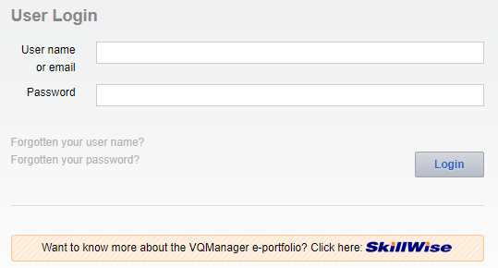
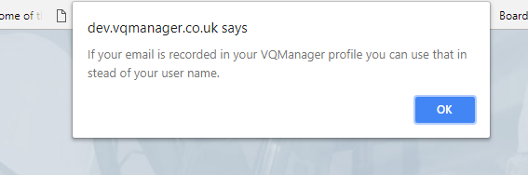
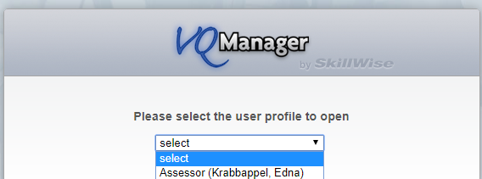
VQManager
In the event of a user having forgotten the user name
We have added the ability for a user to enter an email address in the instance where a user name has been forgotten. This new function will only work if VQManager has a valid email address for the user.
The login screen has now been changed to “User name or email”.
Click on the “Forgotten your user name?” link and this pop up appears, click Ok and enter your email address and your password.
When you enter your email address, if you have more than one account, and they have the same password, a drop-down asks you which profile you would like to log into.

Slide 57
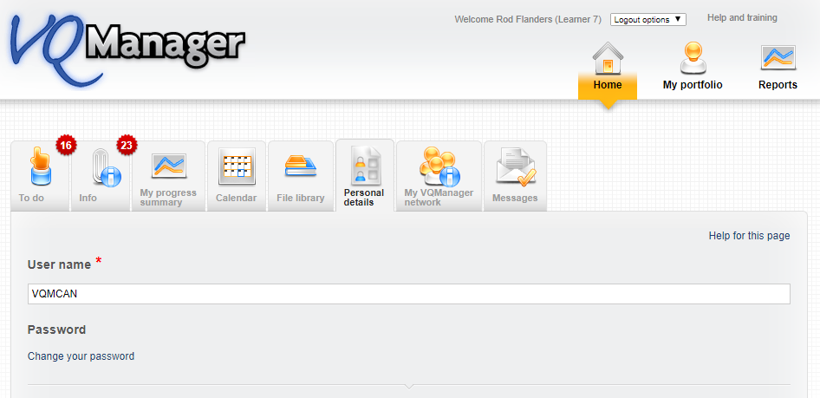
VQManager
Personal Details tab changes in respect of passwords
Previously when the Personal details tab was opened for any user the password was immediately visible. For security reasons, this field is now hidden from view. If the user would like to change their password, they should select the “Change your password” link.
Two new fields appear inviting the user to add and then confirm a new password.

Slide 58
VQManager
GDPR
If you would like a copy of our statement please do let us know

Slide 59
VQManager
Human Firewall

Slide 60
SkillWise
The Human Firewall
Paul Greenhalgh

Slide 61
SkillWise
Security – becoming ever more critical
GDPR
High profile breaches
Technical measures are only part of the solution

Slide 62
SkillWise
FBI “there are just two kinds of companies, those that have been hacked, and those that don’t know they’ve been hacked”.

Slide 63
SkillWise
Porn star names
Notes:
Good game – first pet name, mother’s maiden name – facebook versions, like Tory MP name – tricked into revealing password retrieval info for things like your bank accounts

Slide 64
SkillWise
Cyber attacks – occur way before the day when we discover them.
Spam email?
Identity theft every 3 seconds

Slide 65
SkillWise
Our biggest line of defence – people
Awareness
Notes:
Being aware

Slide 66
SkillWise
Scams becoming more sophisticated
Starbucks scam

Slide 67
SkillWise
Phishing
Whaling
Every 5 minutes
Cultural change – be sceptical
Notes:
Responsibility of every employee to be aware of this and to be vigilant. Did you know that GDPR requires employees to provide periodic cyber awareness training?

Slide 68
SkillWise
Cyber security – not an IT problem, a personal problem
We need to build our human firewalls

Slide 69
VQManager
New development requests

Slide 70
VQManager
Voting

Slide 71
VQManager
Website updates:
New Training videos
Reports

Slide 72
VQManager
Thank you
Paul, Jo, Wil, Kari, Chris and Kim

